Slide 1
Exploratory Data Analysis on TCP Metrics
Aaron Kruchten
Mentors: Bryan Learn and Chris Rapier

Slide 2
Learning Objectives
Become familiar with exploratory Data Analysis Techniques
Learn how to clean messy data
When to impute missing values
Recognizing when data is not useful and when it is appropriate to throw it out
How to form questions about data and apply analysis techniques to properly answer those questions.

Slide 3
Methods
Most analysis was done with R/R studio
Data was stored in an influx DB database.
An open source database built specifically for time series data
Techniques Used Include
Regression analysis: Linear/nonlinear and nonparametric
Cross-validation for evaluating models
Dimension Reduction: PCA
Clustering/Unsupervised Learning: K-means, Spectral, Hierarchical
Causal Discovery Algorithms: PC algorithm with dsepTest

Slide 4
Results/Discussion
Data detailing the performance of two data transfer nodes BR33 and BR34.
Data is measured approximately once every minute and records about 140 different metrics concerning flow performance listed in RFC 4898
Data is larger than 60 gigabytes and contains measurements of approximately 377 thousand flows and 842 million data points.
We were primarily concerned with the following measurements
HCDataOctetsOut, OctetsRetrans, HCDataOctetsIn, ElapsedSecs, CurMSS, PipeSize, MaxPipeSize, CurRTO, CongSignals, CurCwnd, CurSsthresh, Timeouts, CurRwinSent, MaxRwinSent, ZeroRwinSent, CurRwinRcvd,MaxRwinRcvd,MaxRwinRcvd, ZeroRwinRcvd
We did many different kinds of analysis. I will now summarize some of the most interesting things I did over the summer.

Slide 5
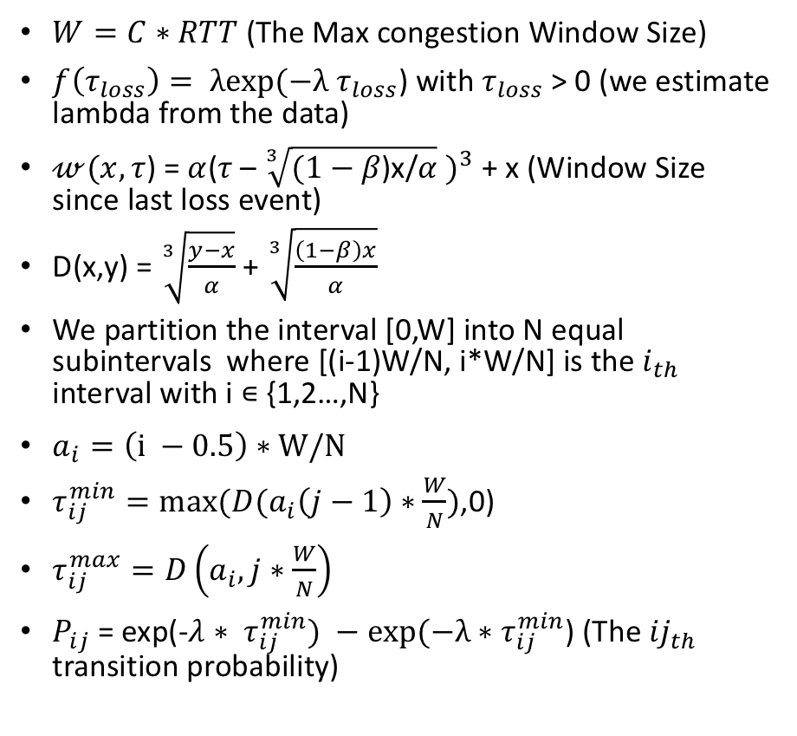
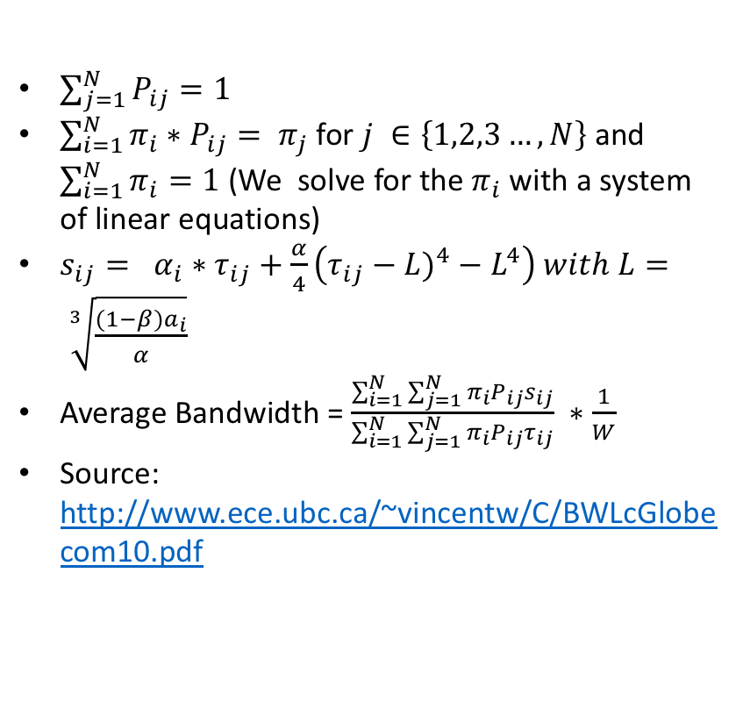
Steady State Throughput Model for TCP Cubic
$W=C∗RTT$ (The Max congestion Window Size)
$f\left(τ_{loss}\right)= λexp(−λ$ $τ_{loss}$) with $τ_{loss}$ > 0 (we estimate lambda from the data)
$𝓌(x,τ$) = $α{\text{(}τ\text{ – }\sqrt[3]{(1−β\text{)}\text{x}\text{/}α} )}^{3}$ + x (Window Size since last loss event)
D(x,y) = $\sqrt[3]{\frac{y−x}{α}}$ + $\sqrt[3]{\frac{\left(1−β\right)x}{α}}$
We partition the interval [0,W] into N equal subintervals where [(i-1)W/N, i*W/N] is the $i_{th}$ interval with i ∊ {1,2…,N}
$a_{i}=\left(i −0.5\right)∗W/N$
$τ_{ij}^{min}=max⁡(D(a_{i}\left(j−1\right)∗\frac{W}{N})$,0)
$τ_{ij}^{max}=D\left(a_{i},j∗\frac{W}{N}\right)$
$P_{ij}$ = exp(-$λ$ ${∗ τ}_{ij}^{min}) −exp(−λ∗τ_{ij}^{min}$) (The ${ij}_{th}$ transition probability)
$\sum_{j=1}^{N}{P_{ij}=1}$
$\sum_{i=1}^{N}{π_{i}∗P_{ij}= π_{j}}$ for $j ∈\left\{1,2,3…,N\right\}$ and $\sum_{i=1}^{N}{π_{i}=1}$ (We solve for the $π_{i}$ with a system of linear equations)
$s_{ij}= α_{i}∗τ_{ij}+\frac{α}{4}\left({τ_{ij}−L)}^{4}−L^{4}\right) with L= \sqrt[3]{\frac{(1−β)a_{i}}{α}}$
Average Bandwidth = $\frac{\sum_{i=1}^{N}{\sum_{j=1}^{N}{π_{i}P_{ij}s_{ij}}}}{\sum_{i=1}^{N}{\sum_{j=1}^{N}{π_{i}P_{ij}τ_{ij}}}} ∗\frac{1}{W}$
Source: http://www.ece.ubc.ca/~vincentw/C/BWLcGlobecom10.pdf
All these formulas depend on the lambda value computed from the data which depends on the exponential distribution assumption we will talk about.

Slide 6
Assumptions of Steady State Model For TCP Cubic
RTT is constant
Not completely true but a fair assumption
Amount of time between packet loss follows and exponential distribution
We don’t have number of packets lost recorded in the data so we must infer it from other measurements. We did this inference in two different ways
(Segments Retransmitted Per Minute)/60
(Octets Retransmitted/Cur Max segment Size)/60
Both give similar estimates

Slide 7
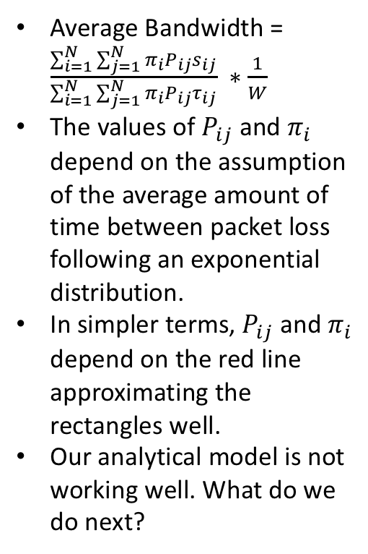
Exponential Distribution Assumption
Average Bandwidth = $\frac{\sum_{i=1}^{N}{\sum_{j=1}^{N}{π_{i}P_{ij}s_{ij}}}}{\sum_{i=1}^{N}{\sum_{j=1}^{N}{π_{i}P_{ij}τ_{ij}}}} ∗\frac{1}{W}$
The values of $P_{ij}$ and $π_{i}$ depend on the assumption of the average amount of time between packet loss following an exponential distribution.
In simpler terms, $P_{ij}$ and $π_{i}$ depend on the red line approximating the rectangles well.
Our analytical model is not working well. What do we do next?

Slide 8
Directed acyclic graph (DAG)
causal graph formed on a random sample of about 2000 flows
About 500 megabytes of data were used
Took 4 hours to complete
Can be parallelized

Slide 9
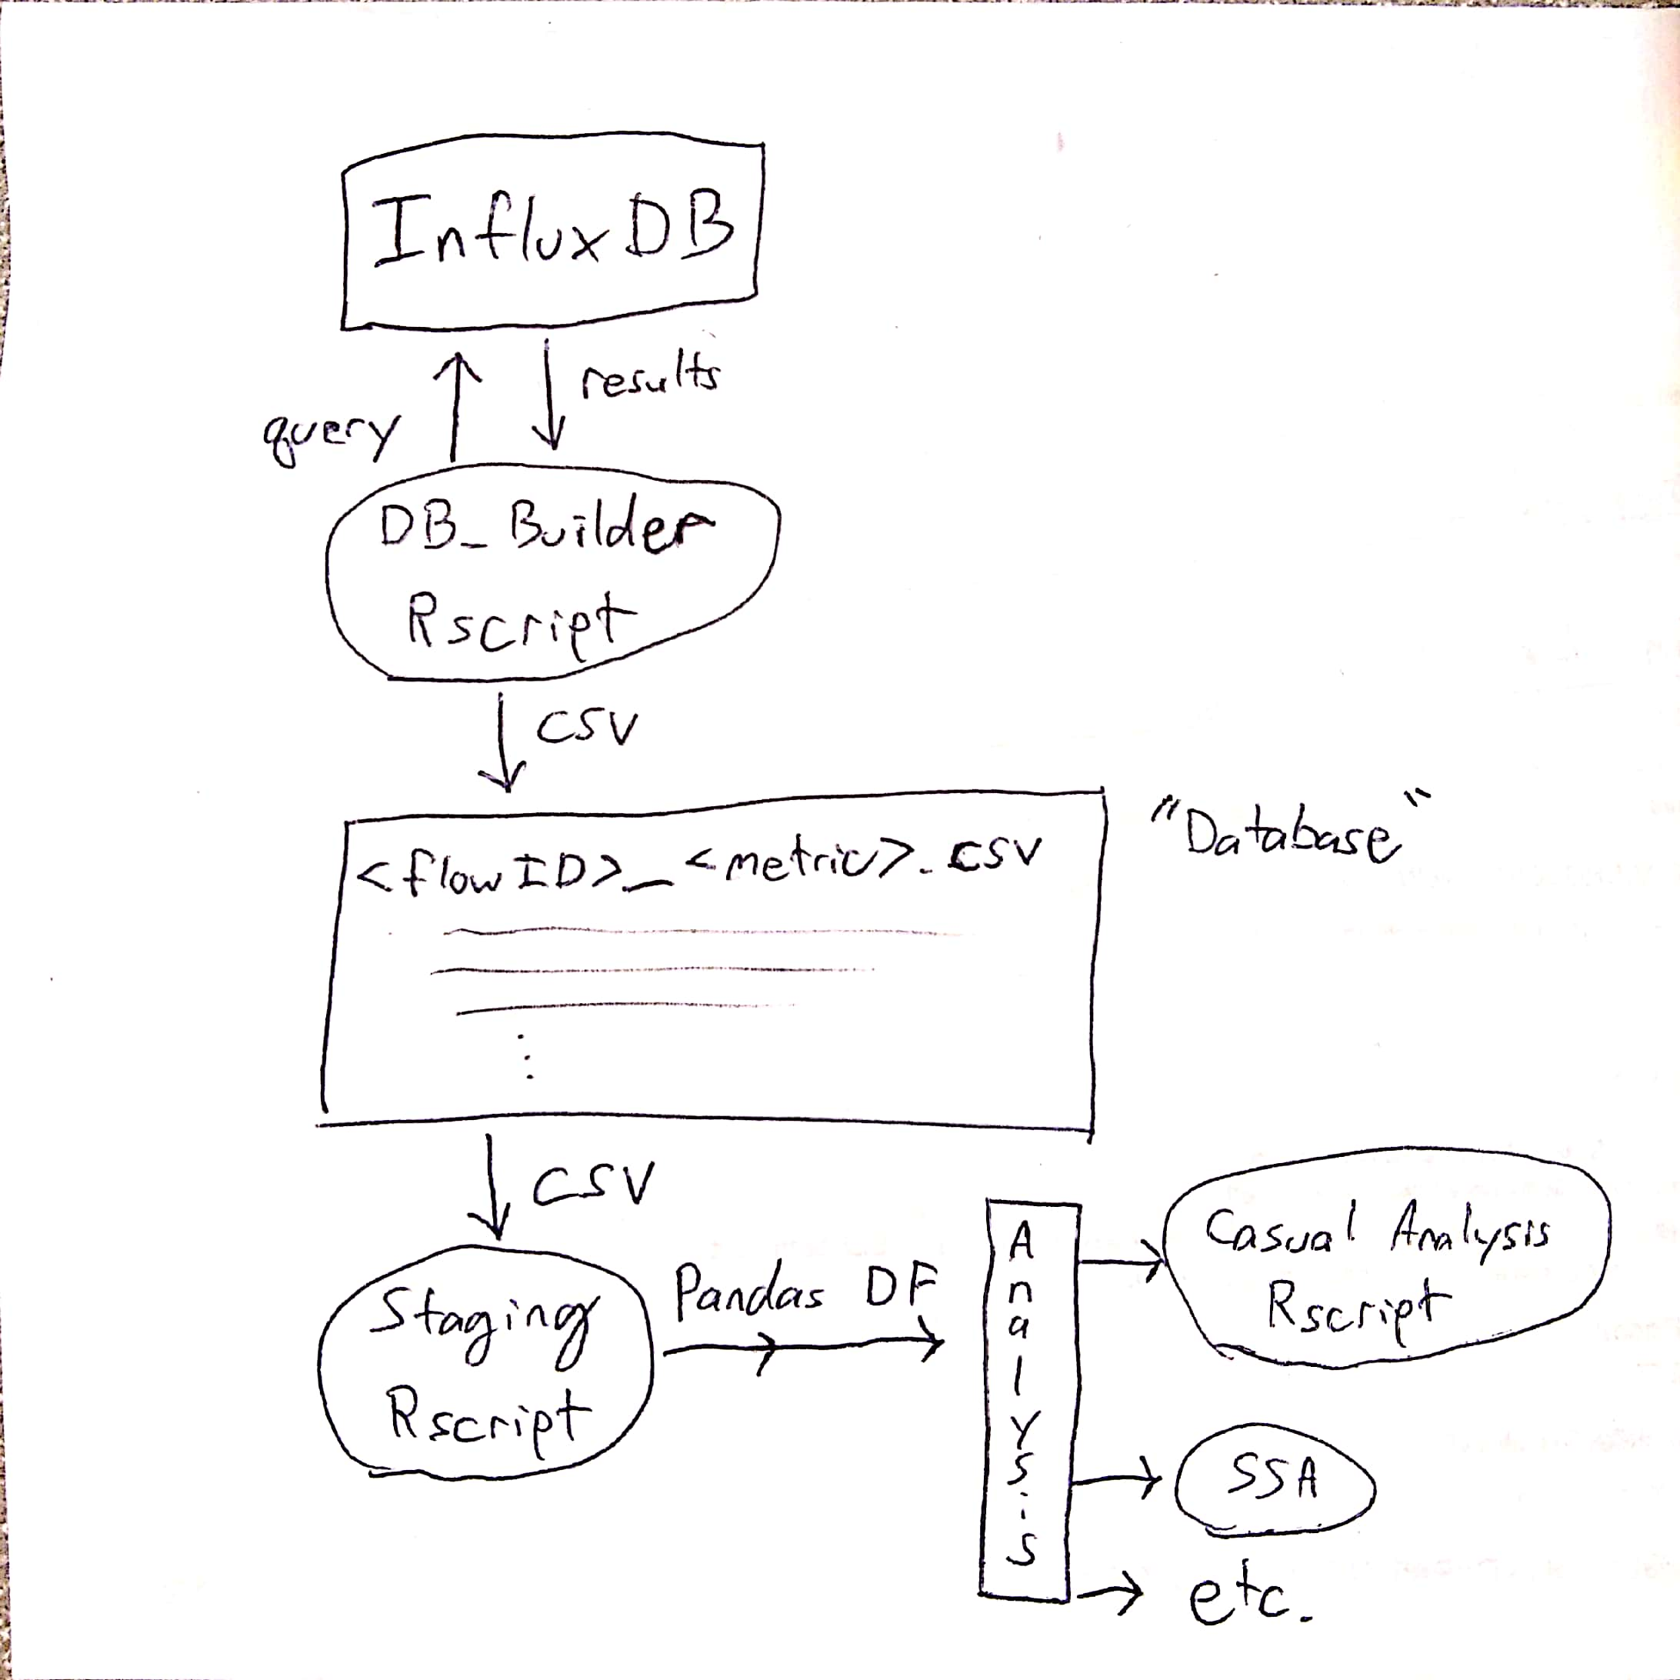
What did we gain from this?
An interface in R that will allow future researchers to easily analyze the data if they want to.
Can easily be converted to a pandas data frame for analysis in Python
https://github.com/AaronKruchten/PSC-EDA

Slide 10
What did we gain from this?
Our Causal analysis verified known facts.
Because of this we are confident that we can use the same algorithms to discover future causalities we are not aware.
Code can be easily modified in the future to answer research questions that may come up.

Slide 11
Acknowledgement

